Slide 1
Handwritten Digit Recognition
By: Andrew Fornash, Bryan Rodriguez, and Sean Goldthwaite
Introduction
For this project we wanted to create a neural network that had the ability to take a handwritten digit that a user drew on a canvas and then determine what that digit was. We used concepts such as feedforward, back propagation and Linear Algebra. Using these concepts we were able to achieve an accuracy of 97% by making a fully connected neural network.
Findings and time complexity
The time complexity for the fully connected neural network is not entirely known but can be estimated at around O(2^n) which can make for some lengthy training periods. As we trained the neural network, we noticed that by the 3rd test as we increased the amount of hidden nodes and epochs the testing data got slightly higher percentages. But as we added another layer to the neural network the testing data percentages got dramatically higher having percentage jumps from as low as 13.21 to 75.2 with only 10 epochs (This can be seen by looking at figure 1 and figure 2). Also as we were increasing the amount of hidden neural networks, we found that if you have over 150 hidden networks the neural network begins to overfit which causes a generalization error and lowers the percentage of the testing data.
How the program works
The program can work from 2 different ways. The user can simply draw a number on the canvas and click calculate and or upload a data set. It then resizes the data inputted to a (28,28) matrix. Once that is done the program the programs loads in the training labels and images. After that’s done it goes to the Neural network guess function which calls the feed forward algorithm which applies the weights and returns an array of 10 probabilities. It then picks the largest probability and returns the number that corresponds with it.

Slide 2
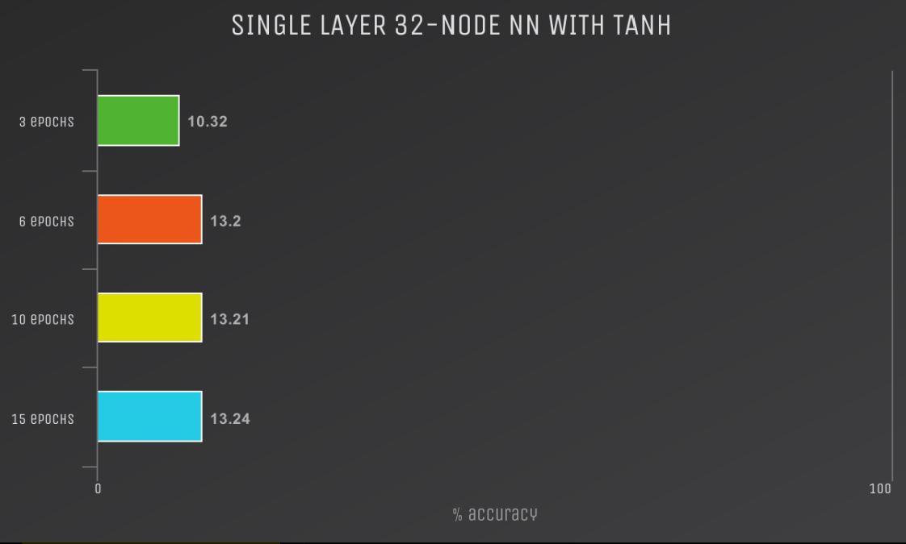
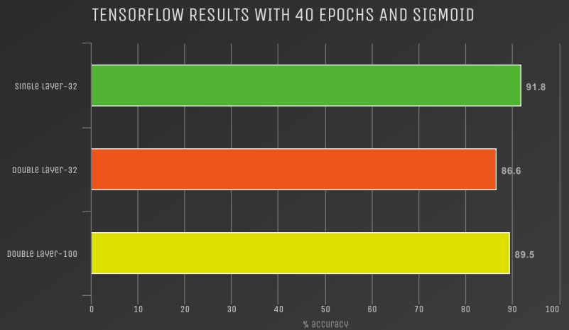
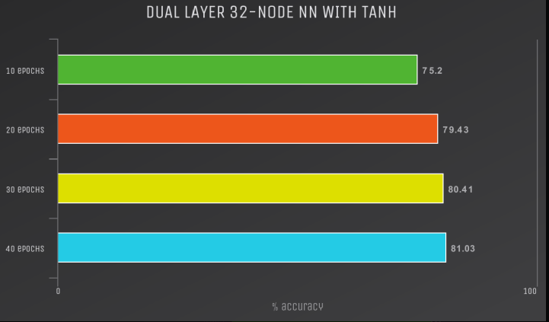
Data Comparisons In order to test our data to see how it would compare to other digit recognizers we used TensorFlow. We used a large batch of 25000 and used a learning rate of 0.01 in order to fairly test our digit recognizers capability. We were surprised to see that for 32 and 100 node double layered NN with sigmoid bests tensor flow even with a significantly lower epoch. However when using an equivalent epoch our Neural Network Sigmoid beats Tensor Flow’s from anywhere between ~ 5.5 to 7.5% This can be seen from figures 3 4, and 5.
Figure 1 single layer 32 node NN with TANH
Figure 3 TensorFlow results with 40 Epoch and Sigmoid
Figure 2 double layer 32 node NN with TANH

Slide 3
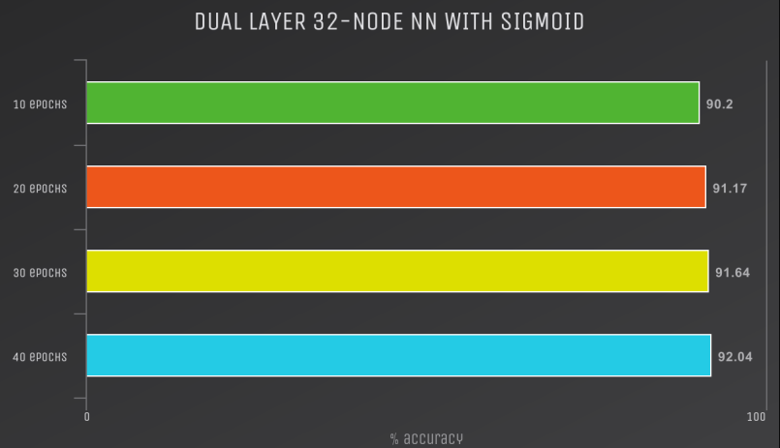
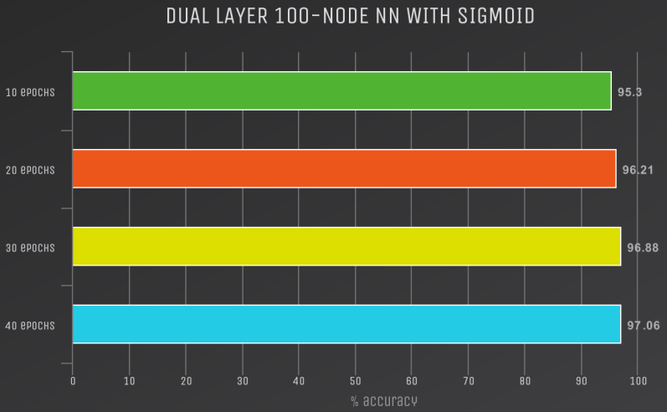
Figure 5 Our Dual Layer 100 Node NN with Sigmoid
In Conclusion
Through trial and error we were able to create a digit recognizer that could compete with TensorFlow in terms of loading data. We learned a lot about neural networks and how important fine tuning them and how large of an impact they can make when made correctly. Overall I believe we can say we all now have a newfound respect for machine learning engineers. The Digit Recognition is an equivalent to the hello world to Machine learning and it took a serious team effort to get where we are today with this project.
Figure 4 Our Dual Layer 32 Node NN with Sigmoid

